Slide 1
TAXI FARE PREDECTION
BY:- "TECH WARRIORS"
M.Mahmad Jebibulla
K.Naveen
M.Pavan Kumar
P.Manoj Kumar
T.Venkateswara Dinesh.

Slide 2
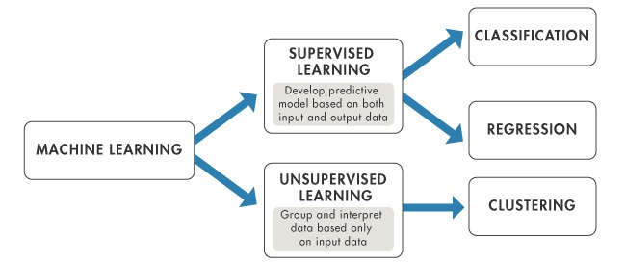
Python:-
Python is a popular programming language it was created by Guido in 1991.
It is used for:
web development (server-side),software development , mathematics , system scripting.
Machine Learning :-

Slide 3
ABSTRACT:-
Present days it is difficult to estimate the taxi fare using dynamic conditions such as Day , time, traffic conditions and also vary from location to location.
To avoid this situation we are deploying a model that will be used for Taxi fare estimation.
Goal of this model is to predict the fare of a taxi trip given information about the pickup location and drop off location , the pickup date & time and also number of passengers travelling.

Slide 4
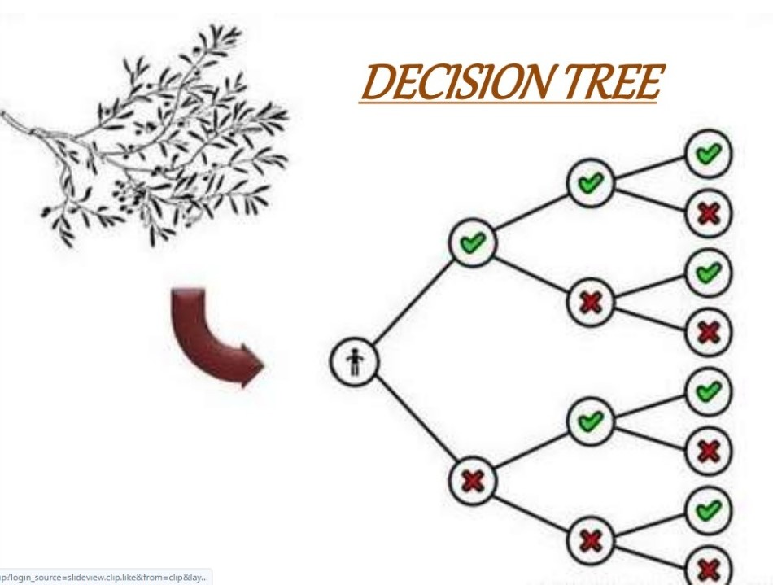
Models used:-
Decision tree regression

Slide 5
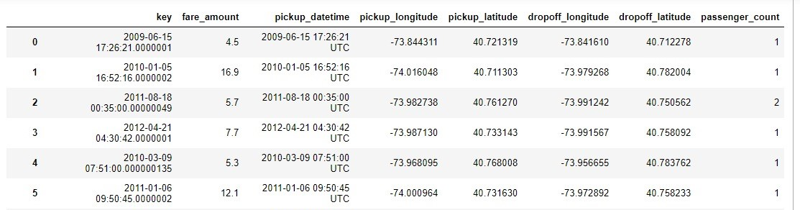
Data Set:-

Slide 6
Steps:-
Step 1:- Collecting Data
Step 2:-Data Wrangling
Step 3:- Analyse data
Step 4:- Train algorithm
Step 5:- Test algorithm
Step 6:- Deployment

Slide 7
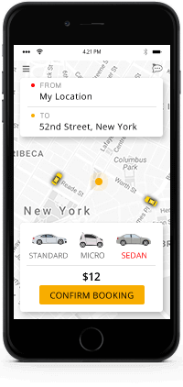
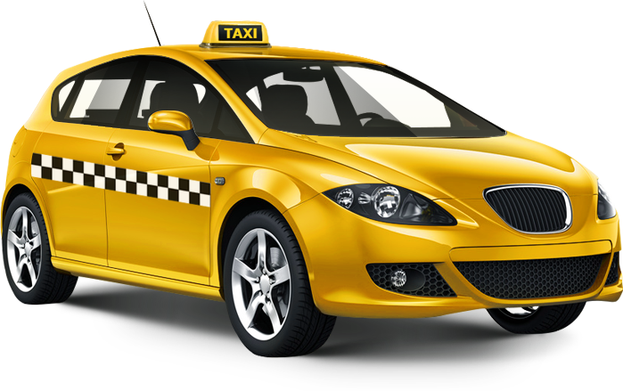
Applications
This model is used to design the mobile applications to locate the taxi and to decide fare amount as per mentioned distance.
Taxi fare model calculates the charges as per the provided pick –up and drop-off location. It compares the price with all the fares that are outlined by the different taxi aggregators.
This model can be used in many
real life purposes like uber, ola,
rapido etc.

Slide 8
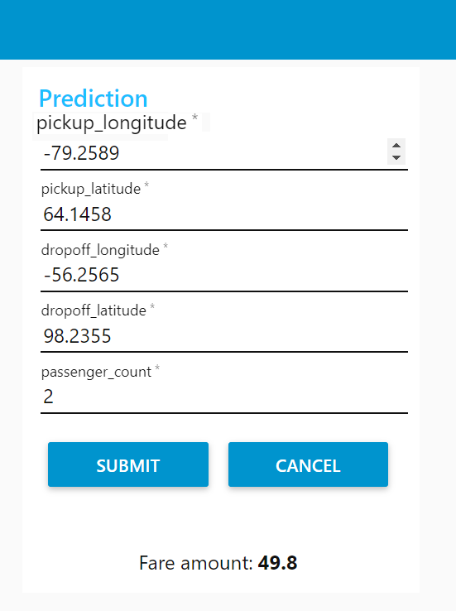
Conclusion:-
Here is our model where we can give input and get fare as output.

Slide 9


